Slide 1

RUNGTA COLLEGE OF DENTAL SCIENCES & RESEARCH
PEDIATRIC RESTORATIVE DENTISTRY
DEPARTMENT OF PEDODONTICS AND PREVENTIVE DENTISTRY

Slide 2
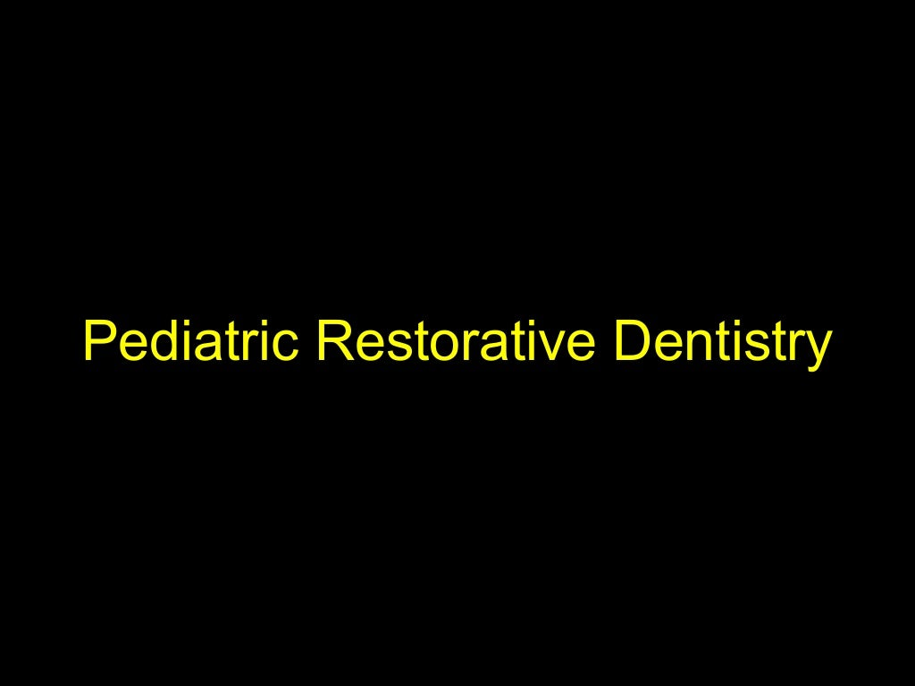

Slide 3
Specific learning Objectives
Core areas | Domain
Introduction Principles of cavity preparation. Modification of cavity preparation | Matrix Wedges Rubber dam

Slide 4
CATEGORY
MUST TO KNOW
NICE TO KNOW
Matrix
DESIRE TO KNOW
Air abrasion
Principles of cavity preparation.
Modification of cavity preparation
Wedges
Rubber dam

Slide 5
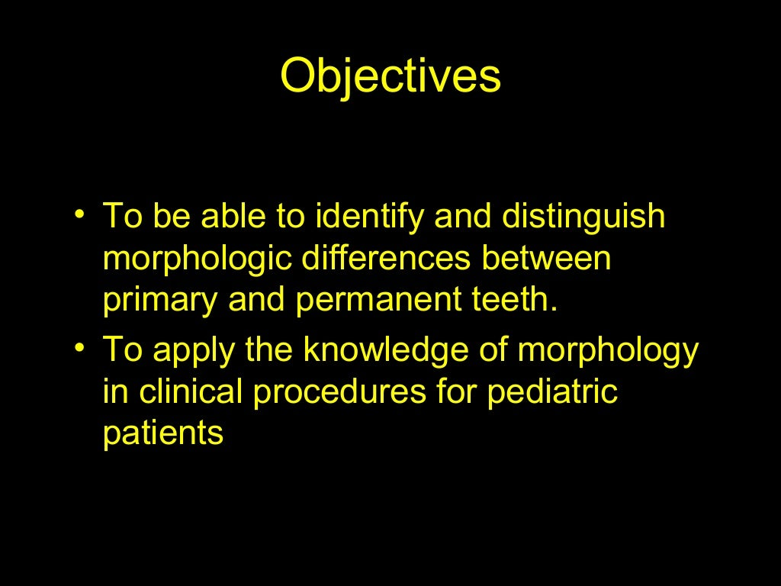

Slide 6
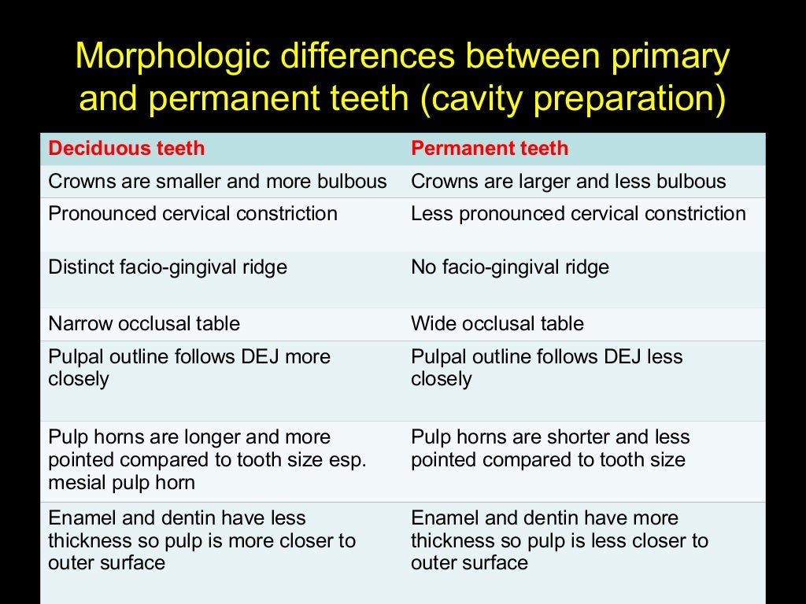

Slide 7
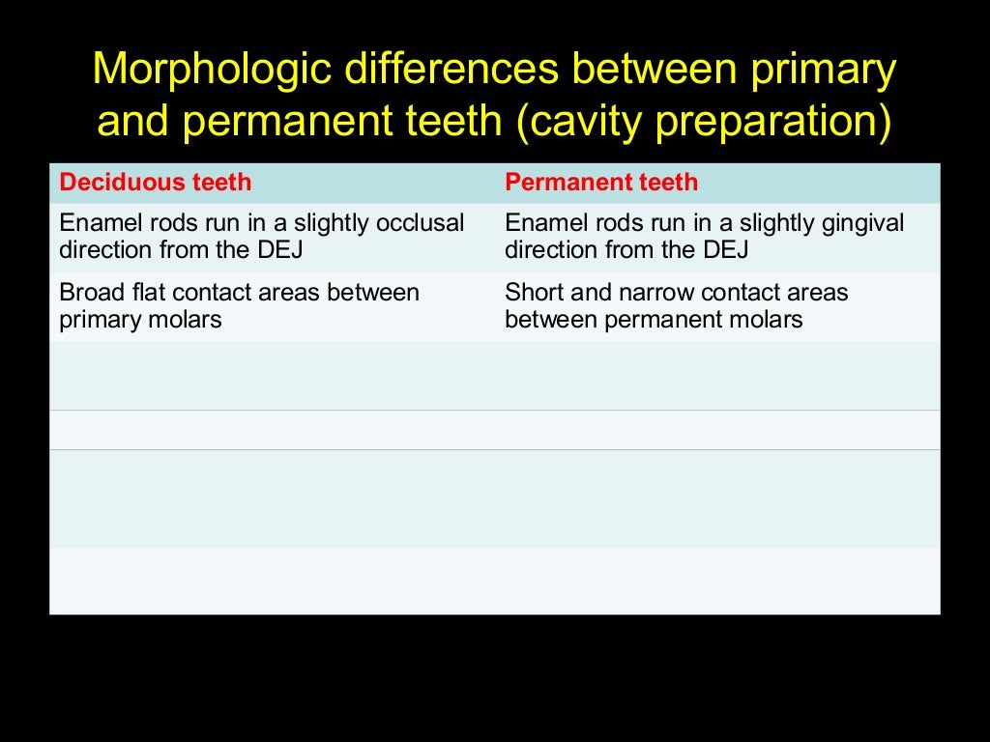

Slide 8
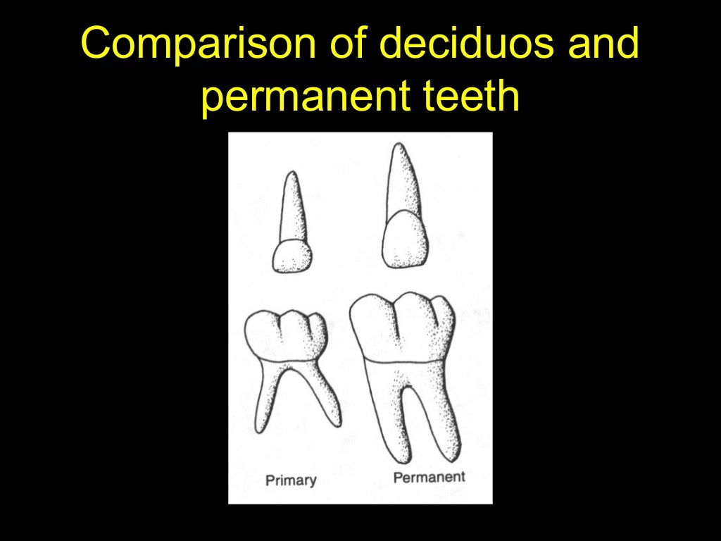

Slide 9
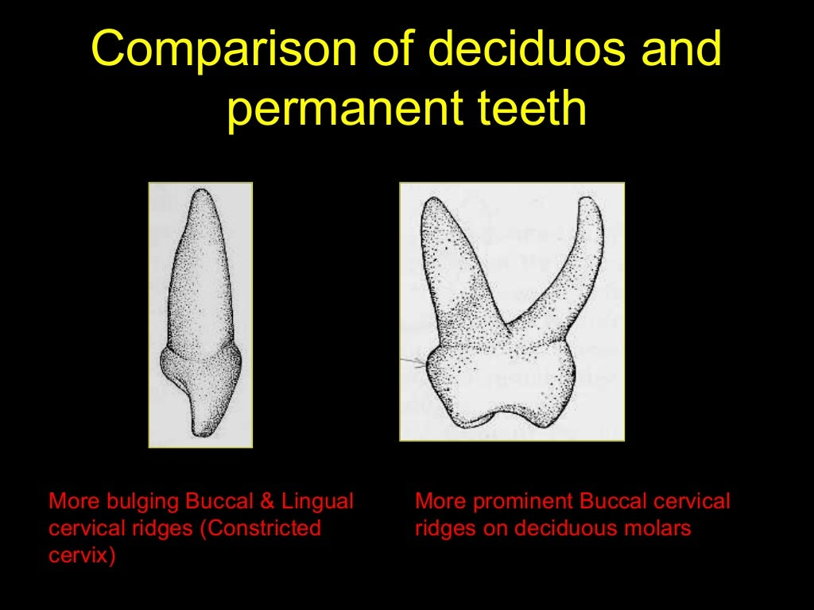

Slide 10
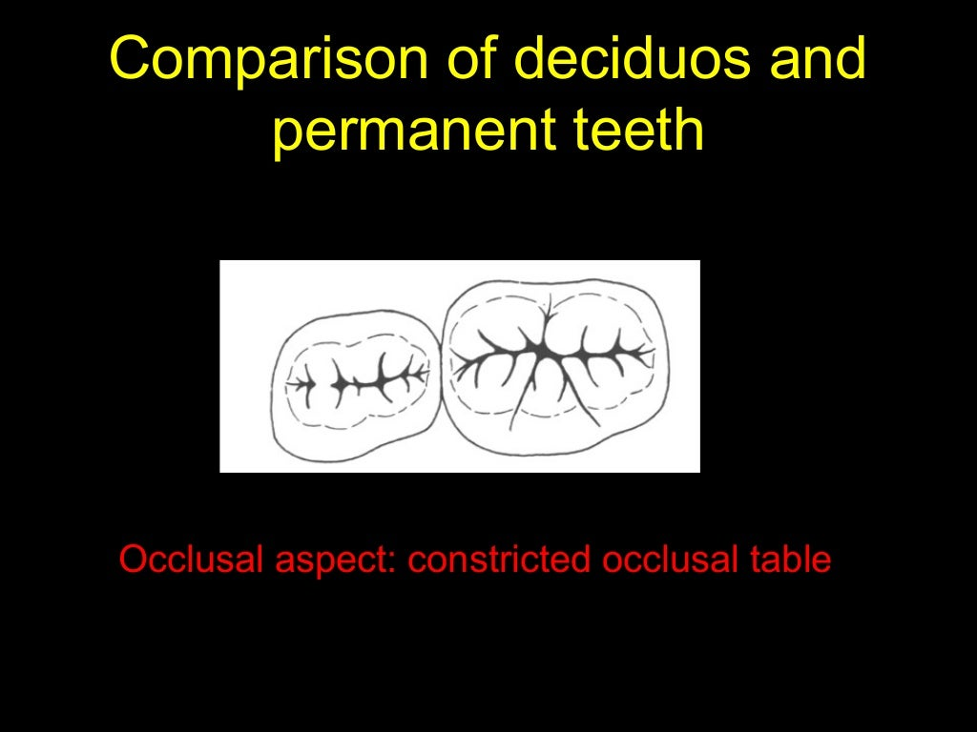

Slide 11
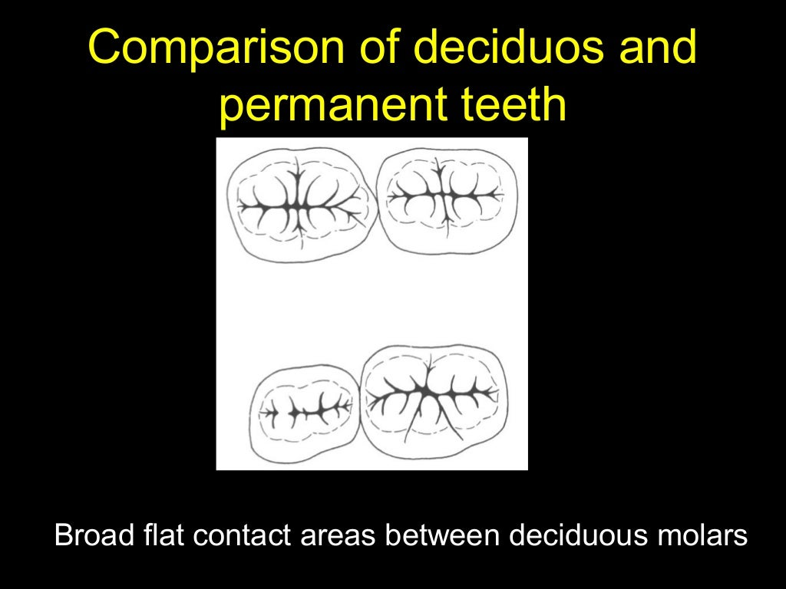

Slide 12
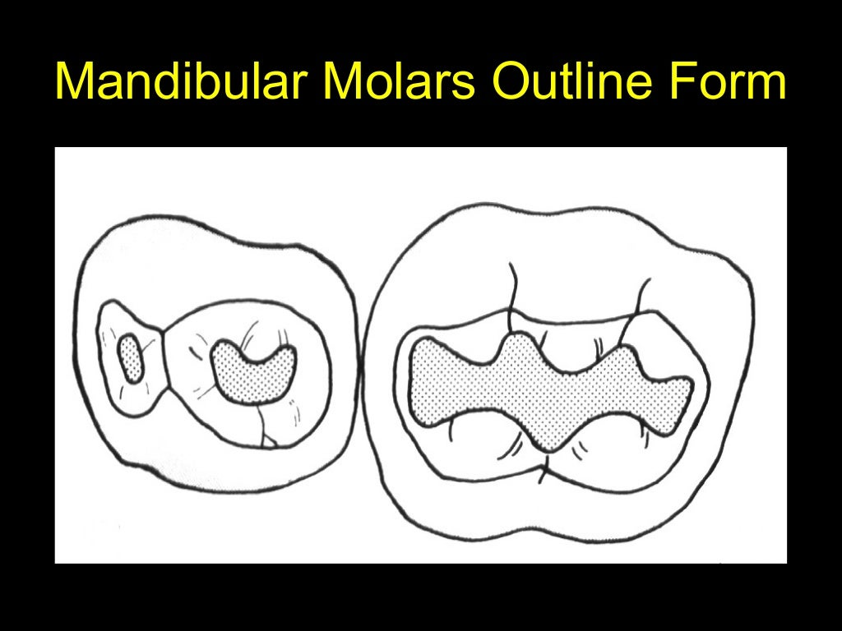

Slide 13
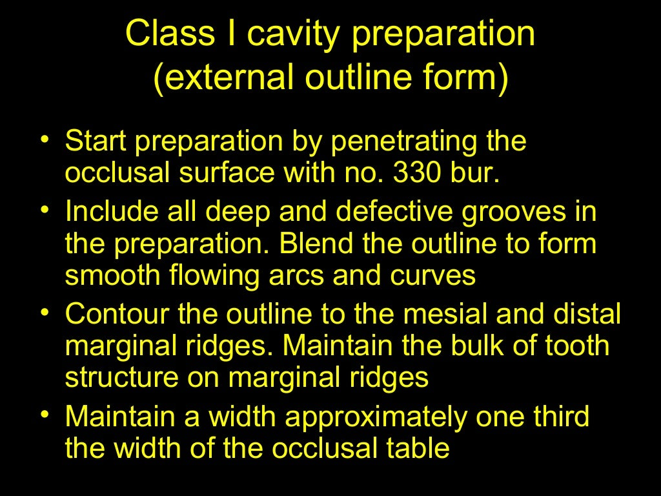

Slide 14
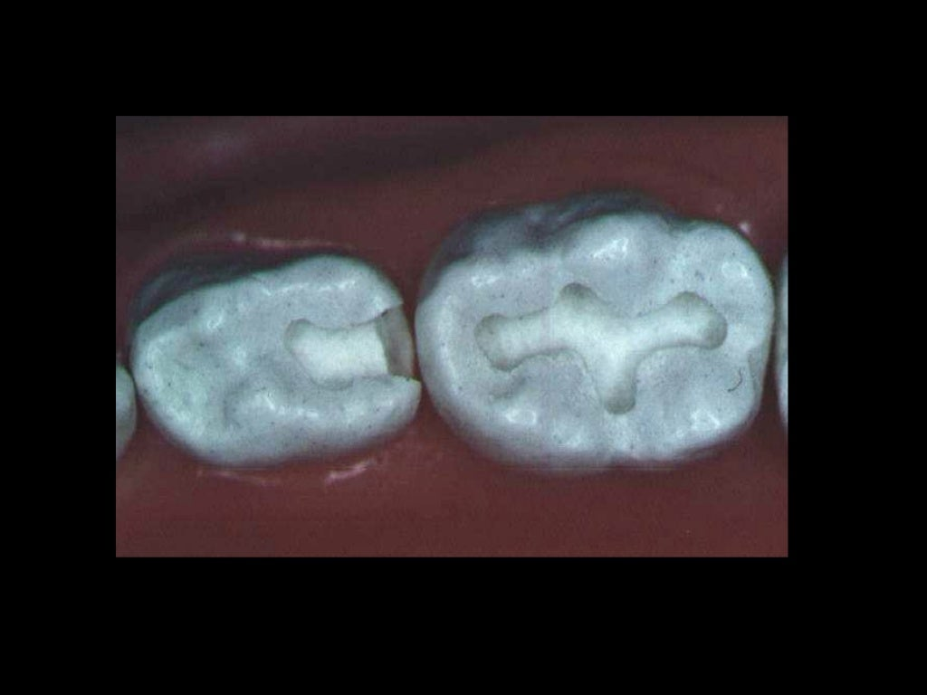

Slide 15
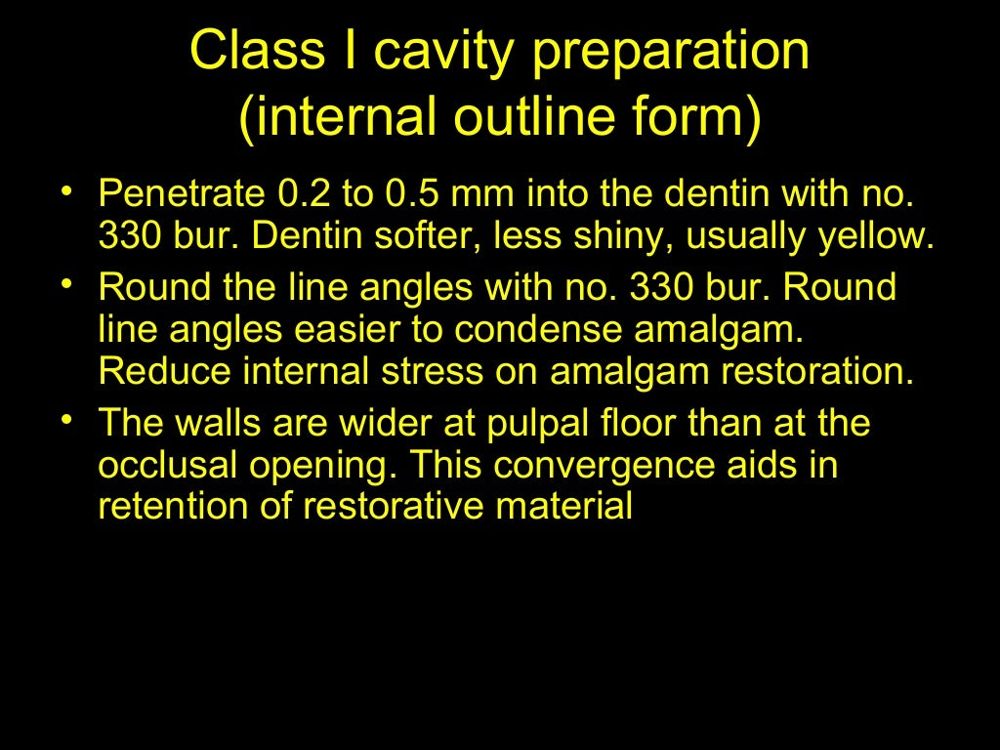

Slide 16
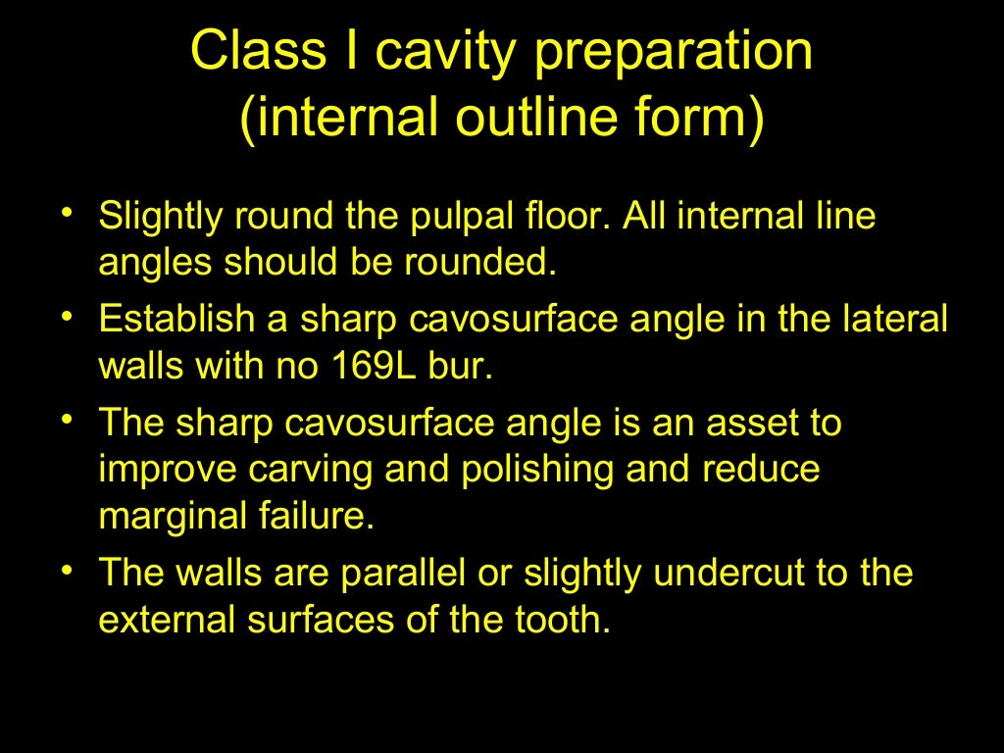

Slide 17
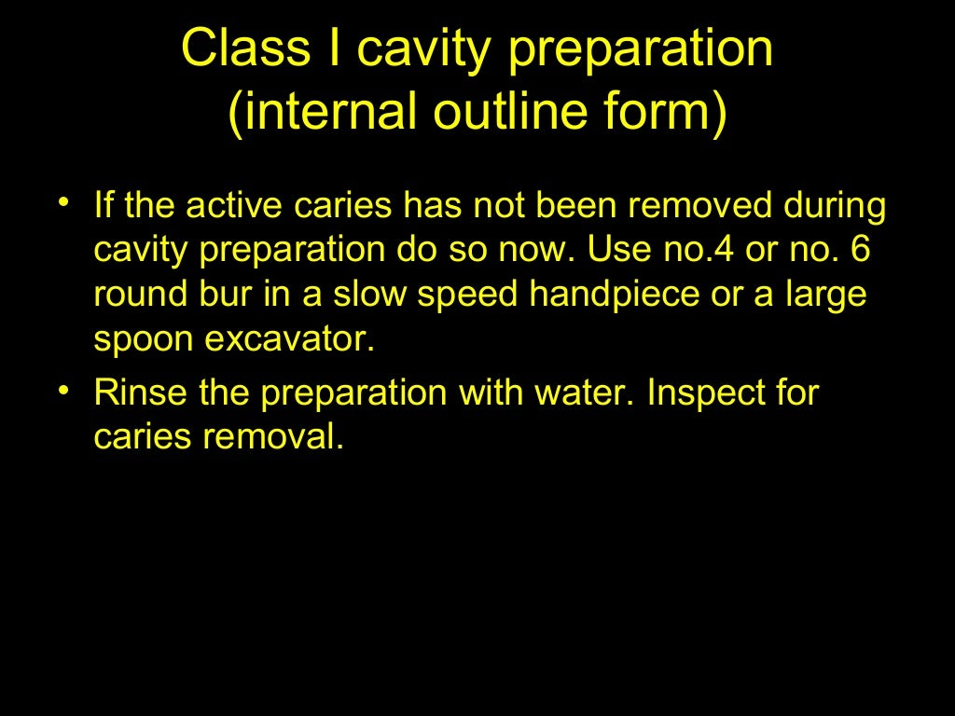

Slide 18
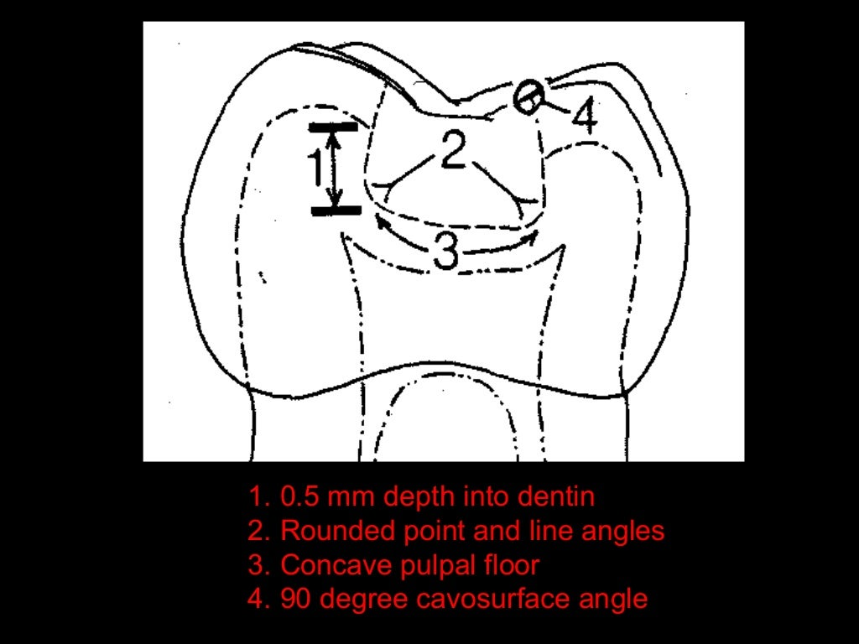

Slide 19
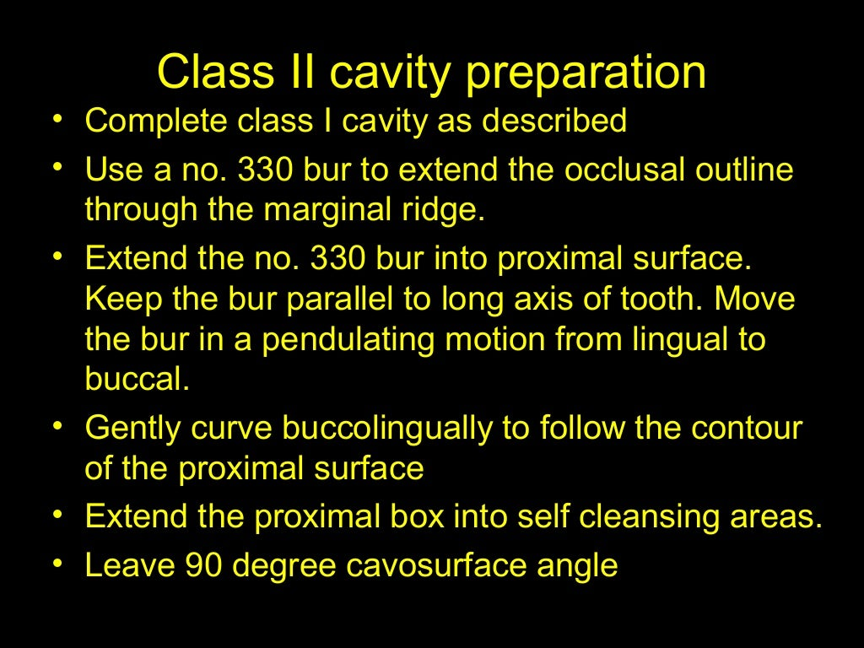

Slide 20
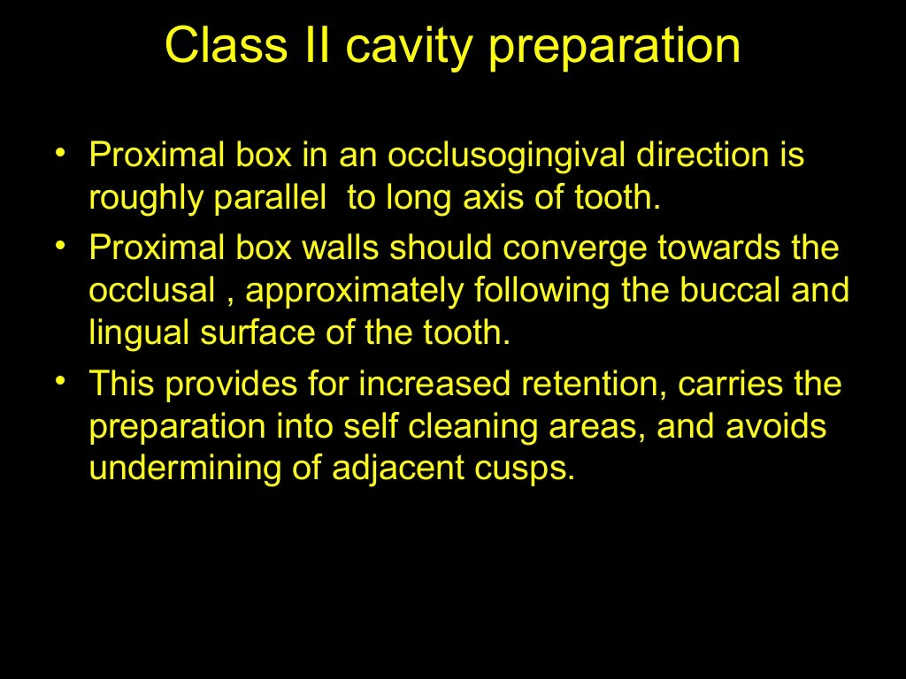

Slide 21
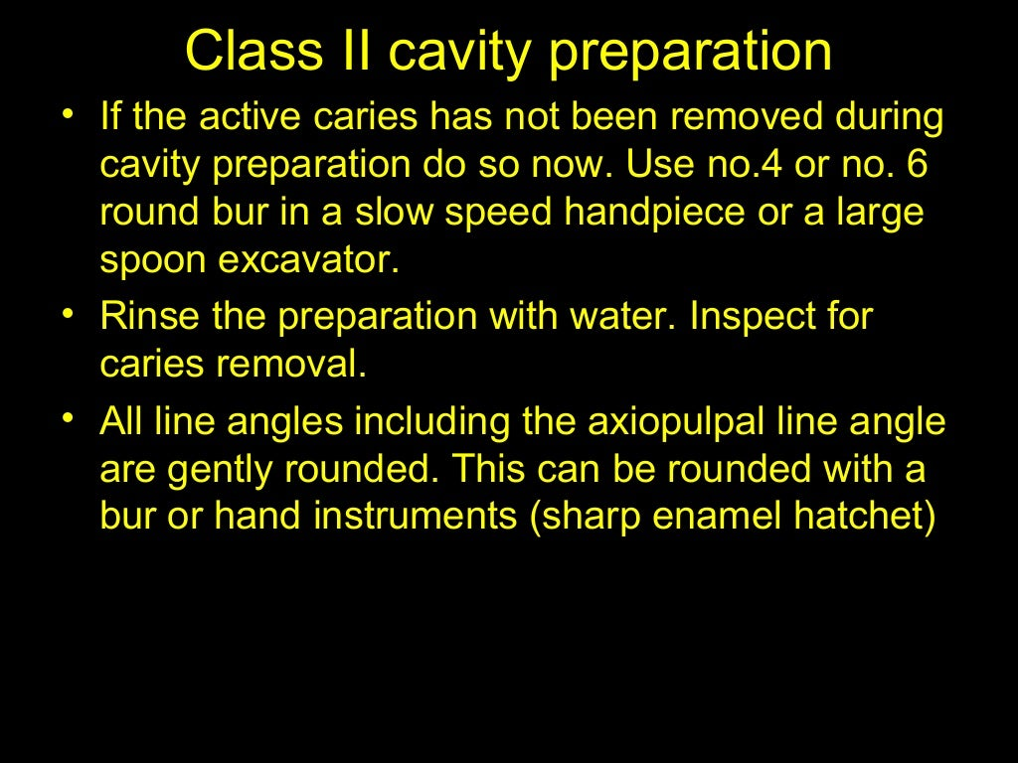

Slide 22
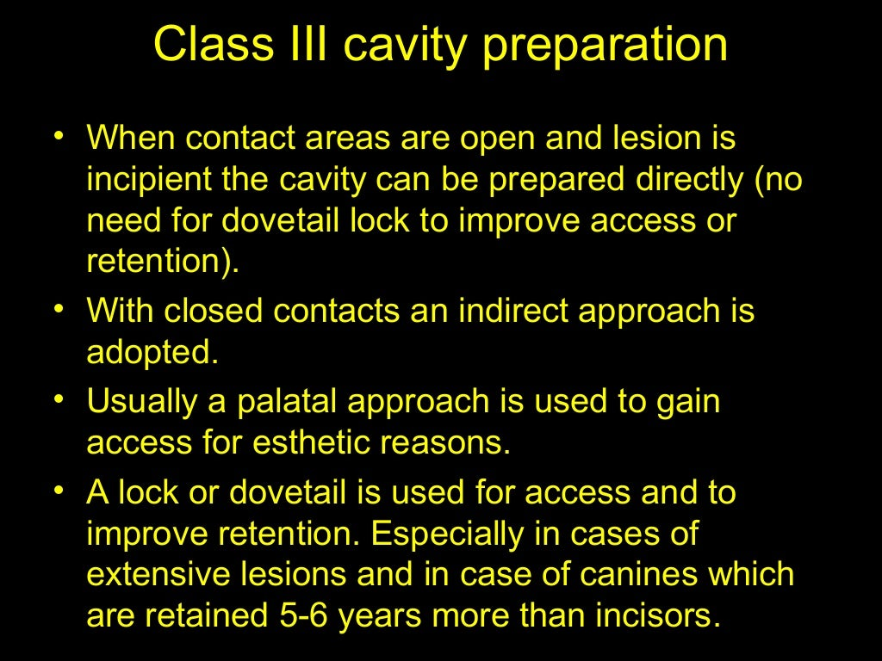

Slide 23
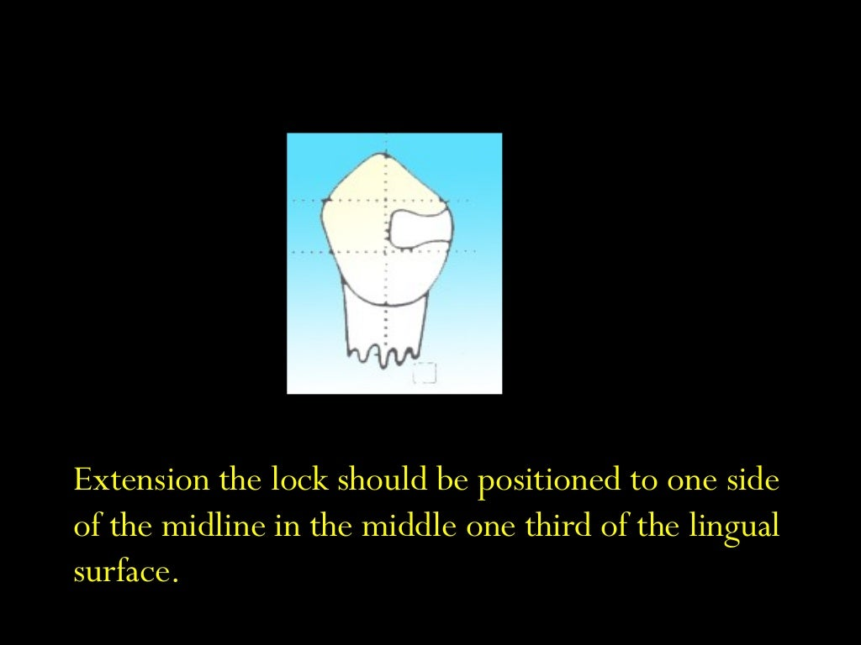

Slide 24
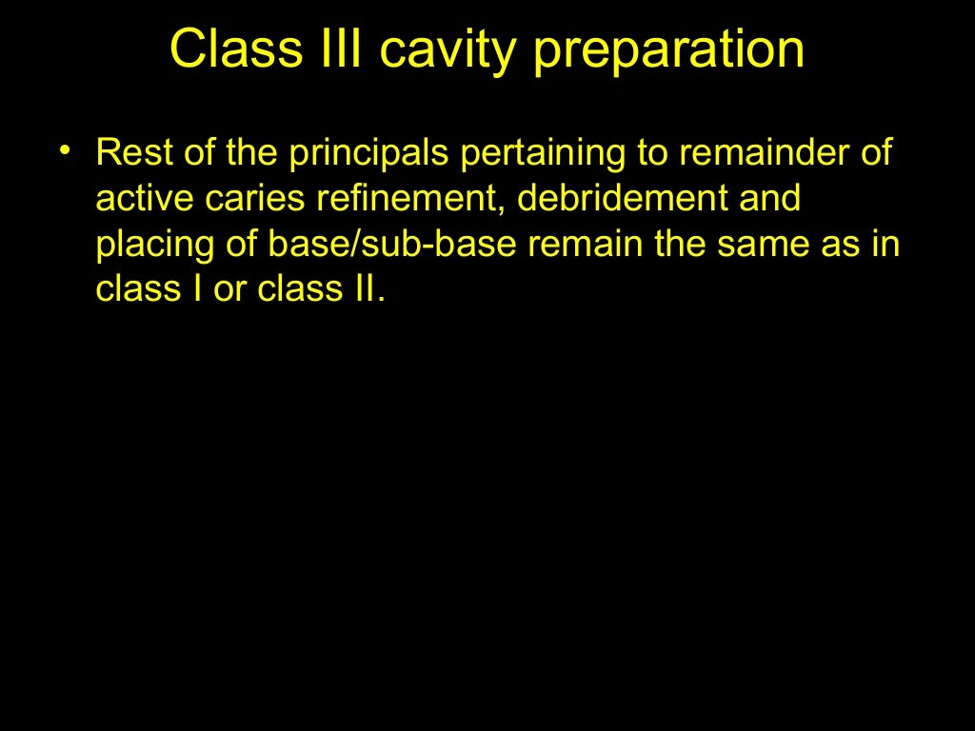

Slide 25
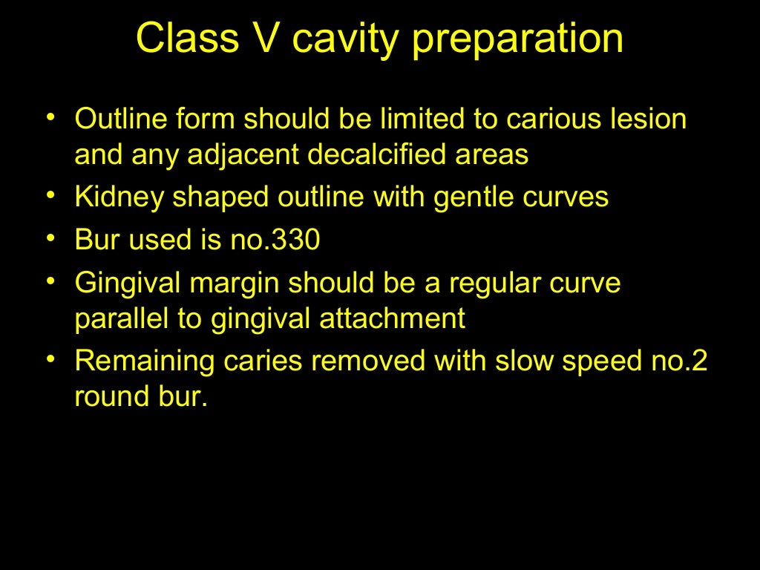

Slide 26
